Slide 1
COVID-19 & Your Workplace
What You Need to Know Today
Returning to Work:
What All Leaders Need to Consider
May 6, 2020 | Kelly Keefe, President, ERC

Slide 2

Welcome
Kelly Keefe, President, ERC
First female President in 98 years
Been with ERC for 16 years
People are an organization’s most valuable asset
Notes:
Welcome and thank you for attending. Happy to be here today

Slide 3
From ERC’s NorthCoast 99 Data
“It would have been simple to take the easy road and play it safe. But the NC99 winners chose a very different path... seeing opportunity where others saw doom, implementing new ideas while others watched from the sidelines, staying positive in spite of an increasingly difficult environment. These organizations are showing us that the ongoing development of a great workplace is the ‘silver bullet’ for organizational success and Northeast Ohio’s regional economic success – both now and in the future.”
      - NorthCoast 99 Winners Report, 2009
Notes:
What will leaders say about your organization in 12 years? This is the time for us to think differently.
A vaccine may not be available for 12-18 months; how are you doing to manage your workplace, not just for the day you return to work but for 30, 60 90 days and up to 18 months. Can we even see that far anymore? As leaders it is hard, but we must continue to plan for not just tomorrow but how our organization will handle this for potentially a year and a half!

Slide 4
Time for Polls!
Where are we today?

Slide 5
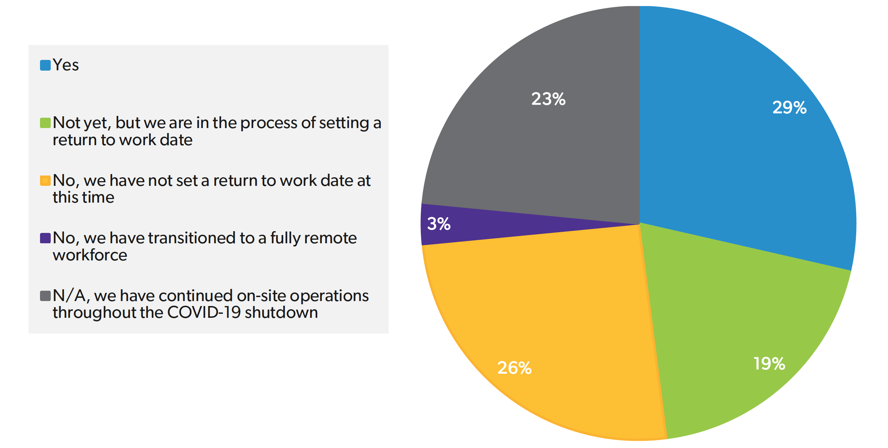
Has your organization set a date to return to work at your physical workplace?
Notes:
Welcome and thank you for attending. Happy to be here today

Slide 6
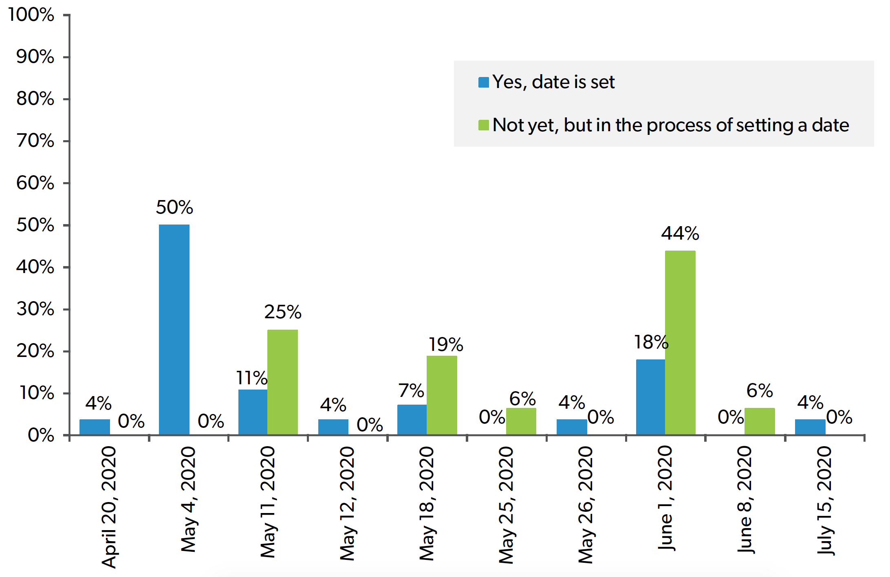
On what date does your organization plan for employees to return to work at your physical workplace?
Notes:
Welcome and thank you for attending. Happy to be here today

Slide 7
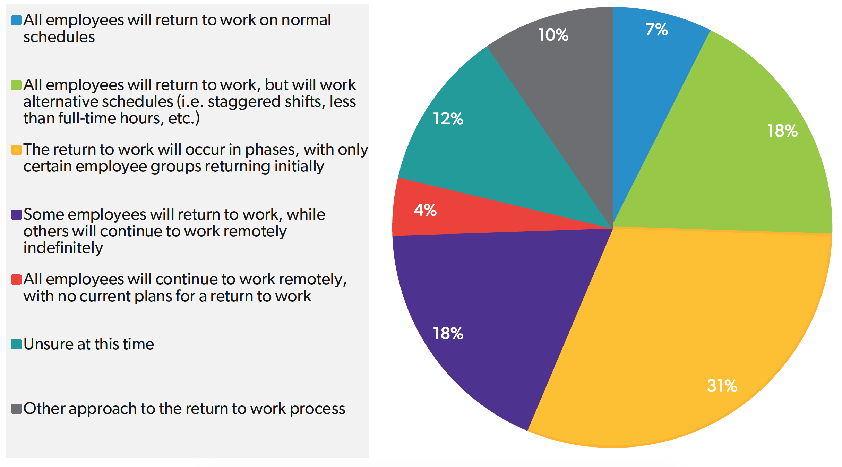
Which of the following statements best describes your organization’s approach to returning employees to work at your physical workplace?
Notes:
Welcome and thank you for attending. Happy to be here today

Slide 8
Today’s Agenda
Provide a safe workplace
Manage employee fear and stress
Contend with the sense of loss
Instill a feeling of confidence
Keep leaders and employees motivated

Slide 9
Provide a Safe Workplace
According to CDC guidance, you should ask three questions when deciding whether to reopen:
  Are you in a community no longer requiring significant mitigation?
  Will you be able to limit non-essential employees to those from the local geographic area?
  Do you have protective measures for employees at higher risk (i.e. teleworking option, tasks that minimize contact)?
Notes:
Hayley: show CDC document (one page document)
Follow the guidelines from the CDC, wanted to share this with you. I know your time is valuable so I will quickly walk you through this.

Slide 10

Reopening Businesses with Workers at Risk for Serious Illness (CDC Guidelines)
Notes:
Welcome and thank you for attending. Happy to be here today

Slide 11
Provide a Safe Workplace
Leaders be Leaders
Create policies
Stick to your polices and enforce them
Create a clean culture from day one

Slide 12
Provide a Safe Workplace
Reconfigure spaces as possible, and consider the following:
  Add partition between receptionists and others that directly interact
  Separate employees who work in adjacent cubicle spaces
  Remove every other chair in break areas and lunchrooms
  Add partitions to tables where employees congregate during breaks
  Require employees to walk in designated one-way lanes in hallways and corridors to avoid “head-on” pedestrian traffic
  Consult with landlords about converting communal restrooms to single-seat bathrooms to avoid close contact between users
Notes:
Read bullets

Slide 13
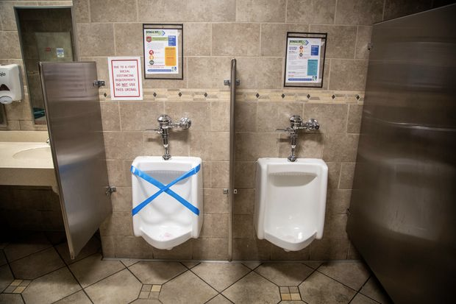
Provide a Safe Workplace

Slide 14
Provide a Safe Workplace
Reconfigure spaces as possible, and consider the following:
  Try to avoid office-sharing and common spaces
  Utilize HVAC contractors to increase the number of air changes
  Arrange for food trucks or other food delivery services to serve employees outside and separate them during lunch breaks
  Provide hand sanitizer stations outside each restroom and each door commonly touched or used
  Upgrade your teleconference equipment—still use technology
  Arrange for pick-up and drop-off delivery of packages outside
Notes:
Read bullets

Slide 15
Provide a Safe Workplace
Reconfigure schedules as possible, and consider the following:
  Stagger work schedules (M/W, T/TH, etc.)
  Stagger work hours, and create more shifts
Discuss travel guidelines:
  Is air travel expected?
  Are overnight trips expected?
Notes:
Read bullets

Slide 16
Provide a Safe Workplace
Other items to consider:
  Shared coffee stations (creamers, mugs, etc.)
  Office refrigerators
  Greeting guests and each other with no handshaking or hugging
  Supply room
  Cleaning door handles, toilet handles, elevator buttons, keyboards, and light switches—increased cleaning needs from cleaning company?
  In addition to considering masks for employees, do they have access to their own cleaning supplies?
  If you are requiring masks, are you providing masks? Are employees responsible for providing themselves? Are they required in closed offices? Lunch rooms?
  Masks—medical reasons for not wearing them and leadership response
Notes:
Read bullets

Slide 17
Provide a Safe Workplace
Have a plan if employee tests positive (or suspected positive) for COVID-19
  Infected employee needs to stay home
  Send home employees who worked closely with infected employee for 14 days
  Extra cleaning and disinfecting
Notify employees while honoring privacy
Notes:
Follow CDC guidelines and office policies

Slide 18
Provide a Safe Workplace
Develop a Business Continuity Plan
  Take into account different locations, geographic considerations
  Create a crisis team or continuity team that can act when needed
  Get input from all departments (create a safety committee)
  What will trigger the plan
  Is communication clear (chain of command and key contacts
  Department of Homeland Security offers template as starting point
  Predict consequences of business disruption (great resources available at (https://www.ready.gov/business-impact-analysis)
Notes:
Read bullets

Slide 19
We Need Great Leadership Now, and Here’s What It Looks Like
“Because leadership in so many different levels and spheres has never mattered so much all at the same time — teachers, principals, presidents, school superintendents, hospital directors, C.E.O.s, mayors, governors, media and parents.
And everywhere these leaders turn they face vexing moral issues and trade-offs. That’s because what started as a health crisis exploded into a humanitarian crisis and then quickly became an unprecedented economic and unemployment crisis. And now it’s also a moral crisis, forcing leaders to balance saving lives and saving livelihoods.”
New York Times, April 21, 2020

Slide 20
Manage Employee Fears and Stress
Regular 1:1 and group communication (have a schedule)
Express gratitude
Show encouragement
Be vulnerable
Be transparent
Offer relaxation, meditation, and breathing techniques
Offer stress management webinars
Create a buddy check-in system
Notes:
Read bullets

Slide 21
Manage Employee Fear and Stress
Make sure to have fun and a sense of humor when possible
Establish internal wellness committee
Provide choice: return to work or WFH (WFH option may be required by law)
EAP, coach or even counselor
Have psychologist as guest speaker or resource
Mental health awareness days
Forced work breaks and time for self-care
Notes:
Read bullets

Slide 22
Manage Employee Fear and Stress
Top leaders need someone to talk to also. Find a coach, group or community!
Notes:
ERC can help with this.

Slide 23
Contend with the Sense of Loss
Meet employees where they are, and be okay with that
Recognize many are processing COVID loss just like the 5 Stages of Grief
  Denial, Anger, Bargaining, Despair, and Acceptance
Help each other move through the process
Some employees may start back to work and have a difficult time adjusting
Be flexible
Notes:
we partner with UH Occupational Health and Wellness Services (https://www.yourerc.com/partners/employee-wellness-services/). I believe that we have pre-negotiated discounts with them, but I have worked with our contact Gary Walker and he can offer organizations a lot of support in this area, in addition to what our partner EAP (Ease at Work) can offer.

Slide 24
Instill a Feeling of Confidence
Open, honest but encouraging conversation about the strength and reputation of the business
Share your plans and communicate short and long term goals
Share your appreciation of team regularly
Be truthful
Be decisive
Be transparent
Notes:
ERC can help with this.

Slide 25
Keep Your Employees Motivated
This is personal to each individual—make it personal for staff
Conduct pulse surveys and use the data
Find out what matters to your direct reports
Most people just want to feel supported, heard, and valued
Offer many words that encourage
Notes:
ERC can help with this.

Slide 26
Other Tidbits
Early retirement
Intern programs
PTO restructuring
Check your Insurance Policies
Notes:
ERC can help with this.

Slide 27
“We can’t moan and lead at the same time!”
-John Maxwell
Thanks to Kevin Doherty, Senior Directory of HR from Gebauer Company for the quote on LinkedIn

Slide 28
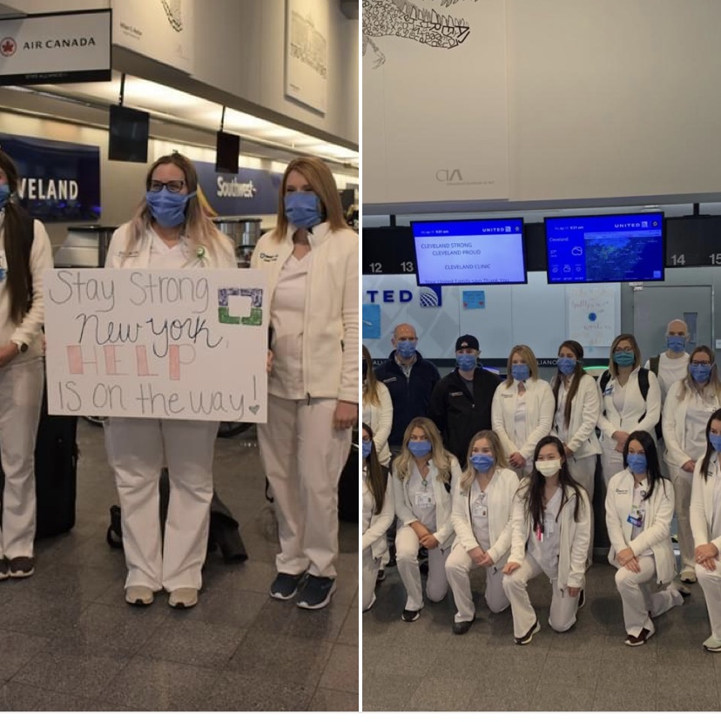
We also can’t beat pictures like this.
Local people.
Doing extraordinary things.
You too, can do this.

Slide 29
